Slide 1


Slide 2








TECH SESSION
AGENDA
Math & Theory
Supervised Machine Learning
Validation
Function Approximation
Neural Networks
Next workshop (TBD): NLP, SQL, Practical Applications
Notes:
Basics of making AI
A small subsection of machine learning
ML is a huge subject—there’s more model types than I can count
I want you to understand the basics of ML and focus on one application -- prediction

Slide 3

What is AI & Data Science Really?
Today’s sessions content
Theory is surprisingly important
AI models are y = mx + b and probability distributions on steroids

Slide 4
What is AI & Data Science Really?
Today’s sessions content
Supervised ML
Unsupervised ML
Artificial Intelligence
Machine Learning
Semi-Supervised
ML

Slide 5
What is AI & Data Science Really?
Today’s sessions content
Supervised ML
Unsupervised ML
Artificial Intelligence
Machine Learning
Semi-Supervised
ML

Slide 6




Making Predictions
Proud Nike Knock Off Shoe Seller
Restock Inventory Daily
How Much to Order
Jim
Does not want to go to jail for counterfeiting

Slide 7

Making Quantitative Predictions
Proud Nike Knock Off Shoe Seller
Restock Inventory Daily
Previous Day Foot Traffic??
Related????
Jim

Slide 8

Making Quantitative Predictions
Proud Nike Knock Off Shoe Seller
Restock Inventory Daily
Previous Day Foot Traffic??
Related????
Jim
y = mx + b

Slide 9
Single Linear Regression
What you were taught
in class..
Daily Shoe Sales
Previous Day Foot Traffic
Daily Shoe Sales = 9.361 + 0.794 * Previous Day Foot Traffic
y = 9.361 + 0.794x
Notes:
Using whole dataset

Slide 10
Past Performance CAN Be Indicative of the Future
What you were taught
in class..
Daily Shoe Sales
Previous Day Foot Traffic
Daily Shoe Sales = 9.361 + 0.794 * Previous Day Foot Traffic
y = 9.361 + 0.794x
Notes:
Using whole dataset

Slide 11




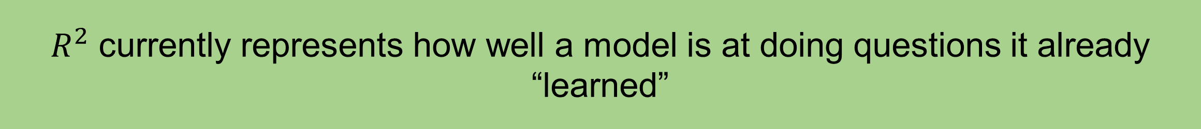

Is My Accuracy Actually Accurate???
When you study, you hope to learn the material… but what if you
are just memorizing the practise questions?
$R^{2}$ currently represents how well a model is at doing questions it already “learned”
We can see the true capabilities of the model in the real world by testing the model on questions it is not already trained on.
This new $R^{2}$ will represent how well the model will truly perform
Notes:
Now.. While our model says it’s 95% accurate… that’s only based on test data that the model was trained on

Slide 12
Splitting Data for Validation
Dependent Variable Y | Independent X1 | Independent X2 | Independent X3
Train Data
Used to train model
50% to 70% of data set
Test Data
Used to validate accuracy
30% to 50% of data set
Notes:
Now.. While our model says it’s 95% accurate… that’s only based on test data that the model was trained on

Slide 13



Model Framework
Train model on
sample data
Test model validity
on remainder of sample
Use model to make predictions

Slide 14
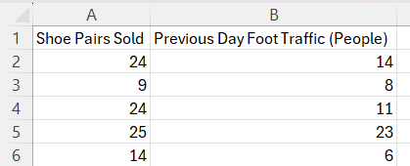
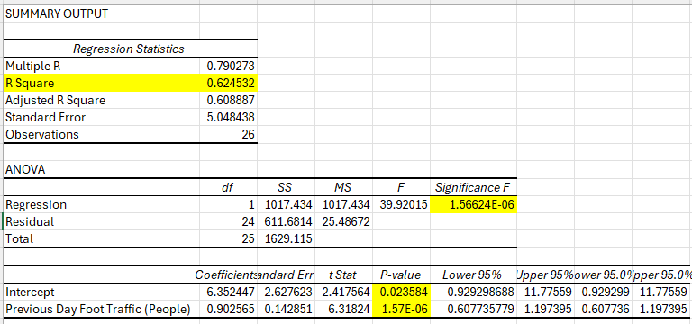
P-value bellow 0.025 for coefficients (except intercept), F-Significance bellow 0.05 and
R-square as high as possible (closer to 1 = better)
Single Linear Regression
For Machine Learning
Daily Shoe Sales
Kinda Mid Ngl…
Previous Day Foot Traffic
Daily Shoe Sales = 9.361 + 0.794 * Previous Day Foot Traffic
y = 9.361 + 0.794x
Notes:
** copy till row 27 for train

Slide 15

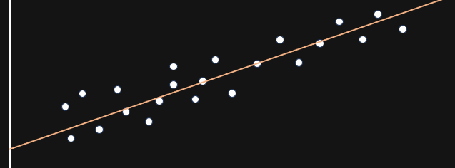

Calculating $R^{2}$ in Test Data
Remainder of 1 subtracted from sum of residuals (data point minus prediction) over the sum of distances of datapoints away from the average
Apply the regression generated formula to test data, and then calculate R square
Residuals
How off is each prediction from reality
Notes:
Now.. While our model says it’s 95% accurate… that’s only based on test data that the model was trained on

Slide 16

Making BETTER Quantitative Predictions
Proud Nike Knock Off Shoe Seller
Previous Day Foot Traffic??
Restock Inventory Daily
Related????
Jim
z = mx + ny + b
Weekly Average Temperature??

Slide 17
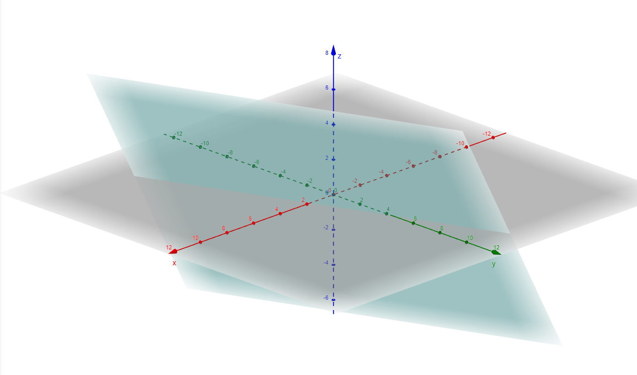
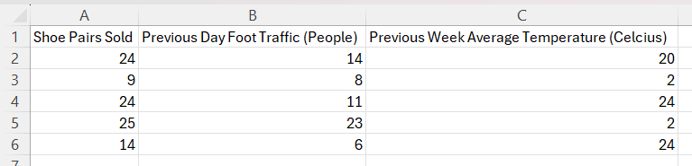
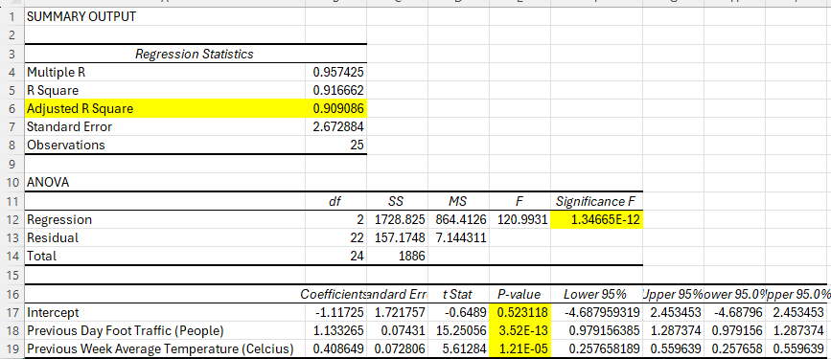
P-value bellow 0.025 for coefficients (except intercept), F-Significance bellow 0.05 and
Adjusted R-square as high as possible
Multi Linear Regression
Daily Shoe Sales = -2.05 + 1.17 * Previous Day Foot Traffic + 0.468 * Previous Week Avg Temp
z = -2.05 + 1.17x + 0.468y
Jim is becoming the Walter White of Counterfeit Shoes 🎉
More Predictive Variables
=
More Dimensions
OVERFITTING RISK
# Predictive Variables
<
# Datapoints (more = better)

Slide 18
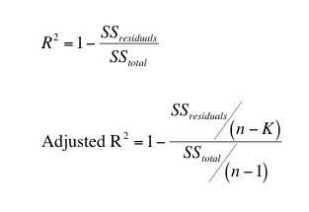

Calculating Adjusted $R^{2}$ in Test Data
Remainder of 1 subtracted from sum of residuals (data point minus prediction) over the sum of distances of datapoints away from the average
Apply the regression generated formula to test data, and then calculate adjusted R square
SSR = Residual sum
SST = Totals sum
n = # data points
k = # of predictive variables
Notes:
Now.. While our model says it’s 95% accurate… that’s only based on test data that the model was trained on

Slide 19
Now Do it In Python

Slide 20
Logistic Classifier
Predict
Qualitative
Events Out of
a Selection
Buying Shoes
Not Buying
Shoes

Slide 21
Confusion Matrix
 | Predicted Outcome
Actual Outcome |  | Positive | Negative
 | Positive | True Positive (Correct Prediction) | False Negative
 | Negative | False Positive | True Negative (Correct Prediction)
Notes:
Now.. While our model says it’s 95% accurate… that’s only based on test data that the model was trained on

Slide 22
Logistic Classifier
import pandas as pd
from sklearn.linear_model import LogisticRegression
from sklearn.metrics import accuracy_score, classification_report, confusion_matrix
import joblib
# Load the data
file_path = 'train3.csv'
data = pd.read_csv(file_path)
# Display the first few rows of the dataset
print(data.head())
# Preprocess the data
# Assuming there are no missing values and no categorical variables to encode
# Define the features and the target variable
X = data[["Spend ($)", "Salary", "Weight (lb)", "Times Visited in Past Year", "Age"]]
y = data["Store Member"]
...
# Create and train the logistic regression model
model = LogisticRegression()
model.fit(X, y)
# Make predictions on the entire dataset
y_pred = model.predict(X)
# Evaluate the model
accuracy = accuracy_score(y, y_pred)
print(f"Accuracy: {accuracy:.2f}")
# Print classification report and confusion matrix
print("Classification Report:")
print(classification_report(y, y_pred))
print("Confusion Matrix:")
cm = confusion_matrix(y, y_pred)
print(cm)
# Calculate True Positive, False Positive, True Negative, and False Negative rates
TN = cm[0, 0]
FP = cm[0, 1]
FN = cm[1, 0]
TP = cm[1, 1]
# True Positive Rate (Sensitivity)
TPR = TP / (TP + FN)
# False Positive Rate
FPR = FP / (FP + TN)
# True Negative Rate (Specificity)
TNR = TN / (TN + FP)
# False Negative Rate
FNR = FN / (FN + TP)
print(f"True Positive Rate (Sensitivity): {TPR:.2f}")
print(f"False Positive Rate: {FPR:.2f}")
print(f"True Negative Rate (Specificity): {TNR:.2f}")
print(f"False Negative Rate: {FNR:.2f}")
# Save the model
model_filename = 'logistic_regression_model.joblib'
joblib.dump(model, model_filename)
print(f"Model saved as {model_filename}")
Notes:
Show problems with using

Slide 23



Function Approximation
We assume outcomes in
the world follow patterns
Patterns can (probably be
graphed as math
equations)
If we can find the equation, we can predict outcome
Thunderstorms happen more often in certain seasons and after many days of no rain
If there is no rain for a long time and it’s a certain season again… it is more likely for a thunderstorm to happen
Maybe we can quantify this relationship with math???

Slide 24
Natural Language Processing
We assume outcomes in
the world follow patterns
Patterns can (probably be
graphed as math
equations)
If we can find the equation, we can predict outcome
Language has structure and follows patterns
The likelihood of what word comes next is related to the words previously said
What if we can predict what the next word will be… given an incomplete sentence

Slide 25
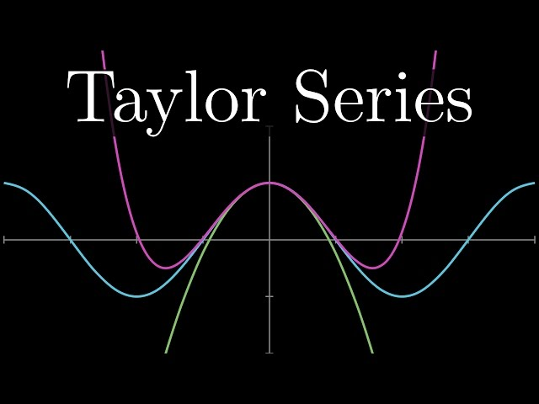
Function Approximation
3Blue1Brown
Taylor Series
Easy to do with few/one data point
Less accurate further away from initial data point

Slide 26
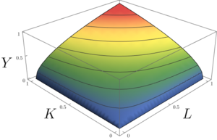

Function Approximation
3Blue1Brown
Taylor Series
Easy to do with few/one data point
Less accurate further away from initial data point
Log-Linear Model
Cobb-Douglas Production Function
Where relationships are not just additive

Slide 27
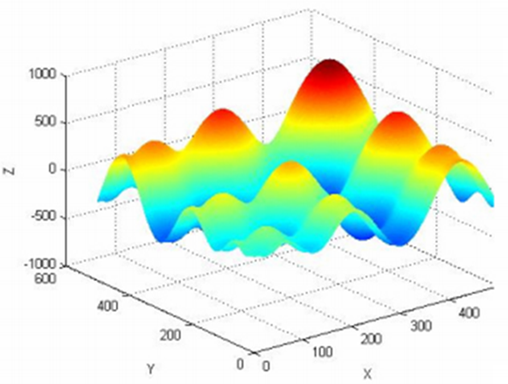
Function Approximation
3Blue1Brown
Taylor Series
Easy to do with few/one data point
Less accurate further away from initial data point
Wasy Research
Log-Linear Model
Cobb-Douglas Production Function
Where relationships are not just addataive
Non-Linear Problems
Lots of stuff in real world does not follow simple patterns
Trying to approximate with linear model decreases accuracy

Slide 28
Function Approximation
3Blue1Brown
Taylor Series
Easy to do with few/one data point
Less accurate further away from initial data point
Wasy Research
Log-Linear Model
Cobb-Douglas Production Function
Qualitative Data
Non-Linear Problems
Lots of stuff in real world does not follow simple patterns
Trying to approximate with linear model decreases accuracy
Could be lots of dimensions to the problem (lots of variables)

Slide 29
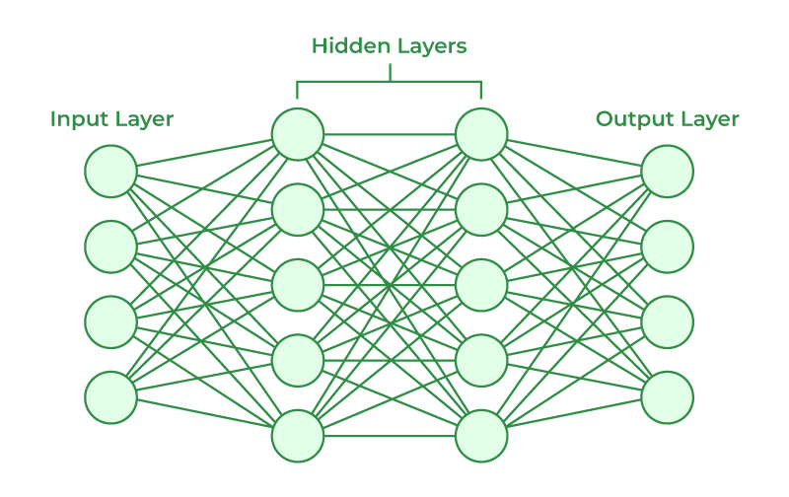
Neural Networks

Slide 30
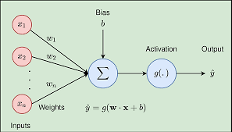
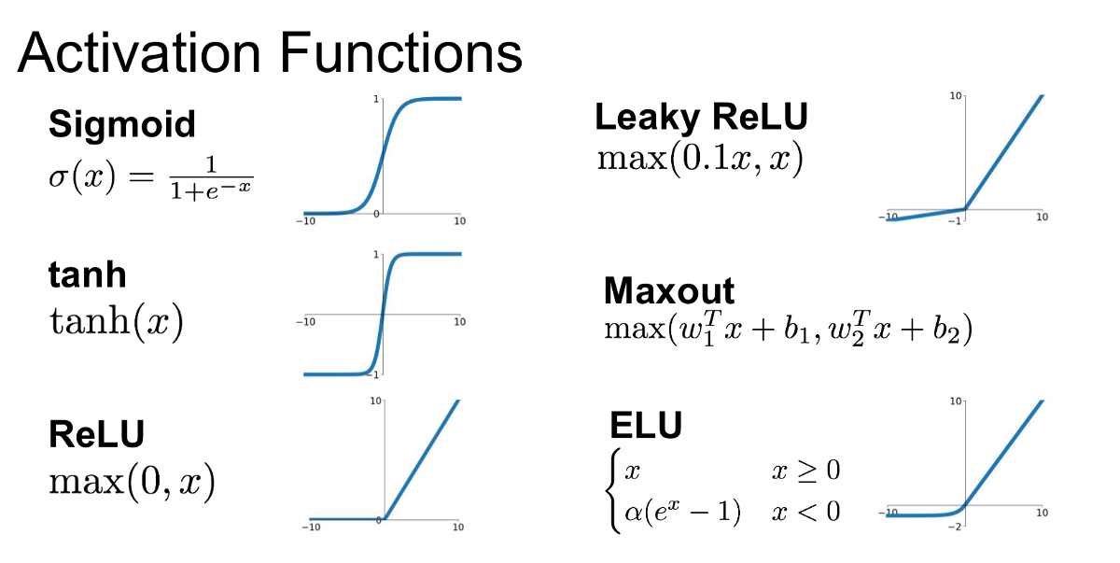

Neural Networks
Multi-Linear Regression:
$y=w_{1}x_{1}$+ $w_{2}x_{2}+w_{3}x_{3}$
Single Layer Neural Network:
$y={g(w}_{1}x_{1}$+ $w_{2}x_{2}+w_{3}x_{3}$)
$g$ is an activation function (convert input number into 1 or 0 or something close)

Slide 31
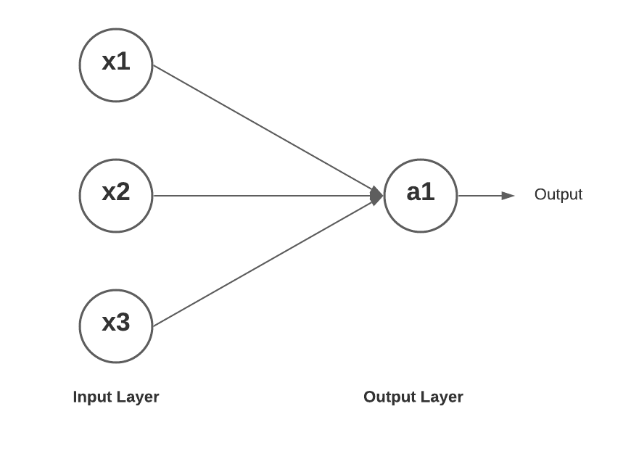



Neural Networks
Multi-Linear Regression:
$y=w_{1}x_{1}$+ $w_{2}x_{2}+w_{3}x_{3}$
Single Layer Neural Network:
$y={g(w}_{1}x_{1}$+ $w_{2}x_{2}+w_{3}x_{3}$)
$g$ is an activation function (convert input number into 1 or 0 or something close)
$$w_{1}$$
$$w_{2}$$
g
y
$$w_{3}$$

Slide 32
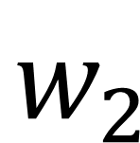
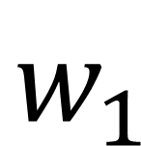




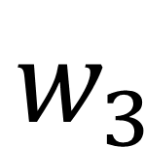
Neural Networks
Multi-Linear Regression:
$y=w_{1}x_{1}$+ $w_{2}x_{2}+w_{3}x_{3}$+ $w_{4}x_{4}$
Single Layer Neural Network:
$y={g(w}_{1}x_{1}$+ $w_{2}x_{2}+w_{3}x_{3}$+ $w_{4}x_{4}$)
$$\begin{matrix}w_{1} \\ w_{2} \\ w_{3}\end{matrix}$$
$$\begin{matrix}x_{1} & x_{2} & x_{3}\end{matrix}$$
$$w_{1}$$
$$w_{2}$$
g
y
$$w_{3}$$
$=w_{1}x_{1}$+ $w_{2}x_{2}+w_{3}x_{3}$

Slide 33

Neural Networks
Multi-Linear Regression:
$y=w_{1}x_{1}$+ $w_{2}x_{2}+w_{3}x_{3}$+ $w_{4}x_{4}$
Single Layer Neural Network:
$y={g(w}_{1}x_{1}$+ $w_{2}x_{2}+w_{3}x_{3}$+ $w_{4}x_{4}$)
$$\begin{matrix}w_{1} \\ w_{2} \\ w_{3}\end{matrix}$$
$$\begin{matrix}x_{1} & x_{2} & x_{3}\end{matrix}$$
$$w_{1}$$
$$w_{2}$$
g
y
$$w_{3}$$
$=w_{1}x_{1}$+ $w_{2}x_{2}+w_{3}x_{3}$
*** pass through activation function g to normalize

Slide 34
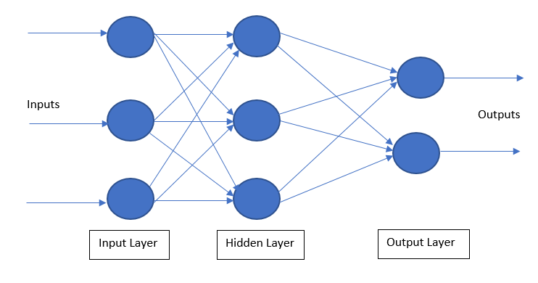
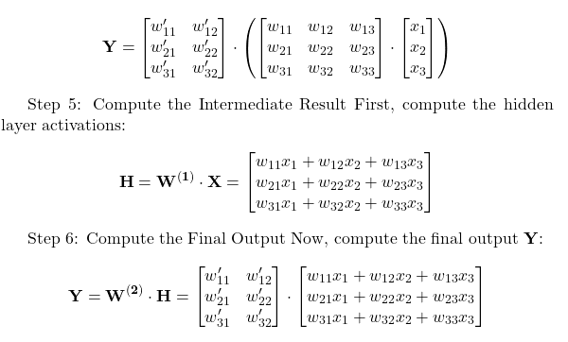
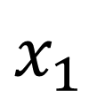
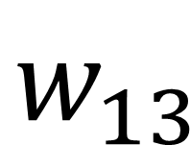
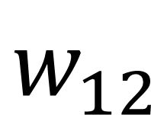
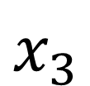
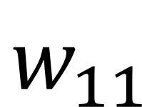
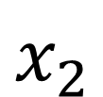
Neural Networks (Multi-Layered Perceptron)
Inputs are fed back into each other after being passed through activation functions until they’re merged at once in the output layer
$$w_{11}$$
$$x_{1}$$
$$w_{12}$$
$$x_{2}$$
$$w_{13}$$
$$x_{3}$$

Slide 35

Neural Networks are Awesome
Multi-Linear Regression:
$y=w_{1}x_{1}$+ $w_{2}x_{2}+w_{3}x_{3}$+ $w_{4}x_{4}$
Single Layer Neural Network:
$y={g(w}_{1}x_{1}$+ $w_{2}x_{2}+w_{3}x_{3}$+ $w_{4}x_{4}$)
They kinda look very similar ngl… 🤔

Slide 36
Neural Networks are Awesome
Multi-Linear Regression:
$y=w_{1}x_{1}$+ $w_{2}x_{2}+w_{3}x_{3}$+ $w_{4}x_{4}$
Single Layer Neural Network:
$y={g(w}_{1}x_{1}$+ $w_{2}x_{2}+w_{3}x_{3}$+ $w_{4}x_{4}$)
They kinda look very similar ngl… 🤔
Neural
Networks are
Universal Function Approximators
Neural networks can approximate Linear (almost as good as linear regression and logistic classifiers)
Neural networks can approximate Non-Linear Functions

Slide 37
Making EVEN BETTER Predictions (Neural Networks)
Proud Nike Knock Off Shoe Seller
Jim

Slide 38


Making EVEN BETTER Predictions (Neural Networks)
Proud Nike Knock Off Shoe Seller Warlord
Jim

Slide 39

Making EVEN BETTER Predictions (Neural Networks)
Proud Nike Knock Off Shoe Seller Warlord
Supply Chain and Marketing Analytics PhD
Jim

Slide 40






Making EVEN BETTER Predictions (Neural Networks)
Proud Nike Knock Off Shoe Seller Warlord
Supply Chain and Marketing Analytics PhD
Jim
Tracking Individual User Browsing Patterns on Google Analytics

Slide 41


Making EVEN BETTER Predictions (Neural Networks)
Proud Nike Knock Off Shoe Seller Warlord
Supply Chain and Marketing Analytics PhD
Predict If Customer will Become a Loyalty Member
Jim
Predict Each Customer’s Spend $

Slide 42
Predicting Loyalty Membership (Classification Neural Networks)
Similar process to Logistic Classifier.. But with way more data points.
import pandas as pd
from sklearn.neural_network import MLPClassifier
from sklearn.metrics import accuracy_score, classification_report, confusion_matrix
import joblib
# Load the data
file_path = 'train4.csv'
data = pd.read_csv(file_path)
# Preprocess the data
# Assuming there are no missing values and no categorical variables to encode
# Define the features and the target variable
X = data[["Spend ($)", "Salary", "Weight (lb)", "Times Visited in Past Year", "Age"]]
y = data["Store Member"]
# Create and train the MLPClassifier model
model = MLPClassifier(hidden_layer_sizes=(5, 7), max_iter=500, random_state=42)
model.fit(X, y)
# Make predictions on the entire dataset
y_pred = model.predict(X)
...
# Evaluate the model
accuracy = accuracy_score(y, y_pred)
print(f"Accuracy: {accuracy:.2f}")
# Print classification report and confusion matrix
print("Classification Report:")
print(classification_report(y, y_pred))
print("Confusion Matrix:")
cm = confusion_matrix(y, y_pred)
print(cm)
# Calculate True Positive, False Positive, True Negative, and False Negative rates
TN = cm[0, 0]
FP = cm[0, 1]
FN = cm[1, 0]
TP = cm[1, 1]
# True Positive Rate (Sensitivity)
TPR = TP / (TP + FN)
# False Positive Rate
FPR = FP / (FP + TN)
# True Negative Rate (Specificity)
TNR = TN / (TN + FP)
# False Negative Rate
FNR = FN / (FN + TP)
print(f"True Positive Rate (Sensitivity): {TPR:.2f}")
print(f"False Positive Rate: {FPR:.2f}")
print(f"True Negative Rate (Specificity): {TNR:.2f}")
print(f"False Negative Rate: {FNR:.2f}")
# Save the model
model_filename = 'mlp_classifier_model2.joblib'
joblib.dump(model, model_filename)
print(f"Model saved as {model_filename}")

Slide 43
Potential Problems
Sometimes, your data does not fit patterns or an ML model is unable to recognize these patterns
Try adding more datapoints
Modify number and size of neural network hidden layers
Try different ML models
Use different predictor variables
Accept there is no pattern… sometimes that’s just the case
Some of your independent variables are related to each other
Look into the multi-collinearity problem in Linear Regression and eliminate highly correlated variables
Overfitting
More datapoints or fewer hidden layers and nodes

Slide 44
NEXT
STEPS

Slide 45
If You’re Interested…
How LLMs Work
Unlikely to ever need to build a transformer model from scratch
Reinforcement Learning
Using reward functions to self-train AI models (unsupervised models)
Mostly useful for research applications
Other Supervised ML Models
Bayes Classifiers
K-Nearest Neighbour
Random Forest

Slide 46
Next Workshop
ML/AI with Text Data
Training ML models for text data
Using LLM APIs for analysis
Dynamic Software Functionality with LLMs
Extending your software functionality via LLMs
Quickly integrating chat controls to your software
SQL Intro
Very useful when automating a data pipeline for prediction

Slide 47
THANKS FOR LISTENING

Slide 48
Resources
ChatGPT for coding ☺
Taylor series | Chapter 11, Essence of calculus – YouTube
https://www.youtube.com/watch?v=aircAruvnKk
Why Neural Networks can learn (almost) anything (youtube.com)

